Slide 1

Bioinformatic approaches to regulatory genomics and epigenomics
376-​1347-00L - 2022
Pierre-Luc Germain

Slide 2
Plan for today
About your lecturer
About your fellow students
What’s epigenetics/epigenomics?
Structure of the course
Expectations and evaluations
Introduction to the practical tools for the course:
R notebooks, bioconductor, git & github

Slide 3

About your lecturer
Oberassistent & Junior PI at the D-HEST Institute for Neurosciences (ETH) & Lab of Statistical Bioinformatics (UZH)
From Quebec, Canada
Background in the humanities (history and philosophy of the life sciences):
biological functions & evolutionary explanations, animal experimentation, modeling & extrapolation, molecular oncology, etc.
Biological research:
gene expression regulation in stem cells, germline and the brain; brain and cellular responses to stress; genetics of neurodevelopmental disorders
Bioinformatic research:
methods for bulk and single-cell transcriptomics and epigenomics; miRNA target prediction; TF binding & activity inference, reconstruction of transcriptional networks

Slide 4
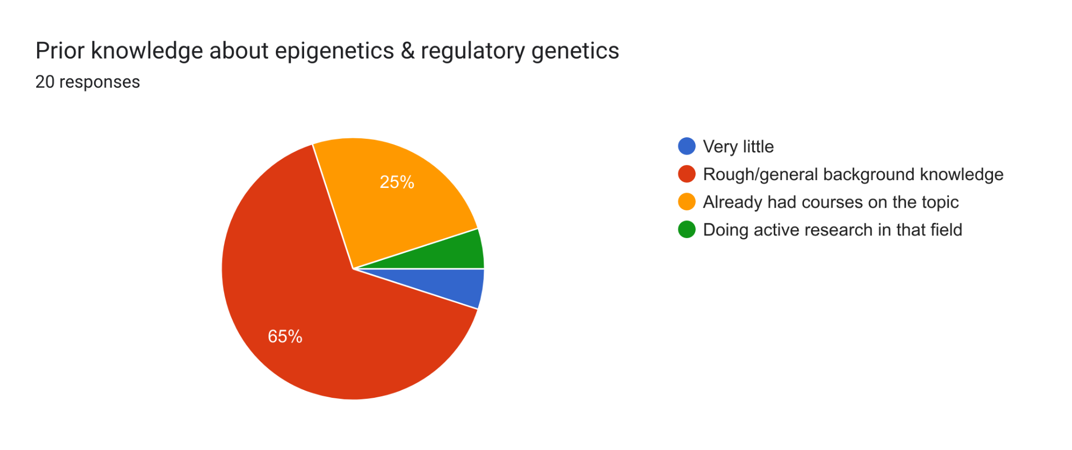
About your fellow students
Chiefly master students, a few doctoral students and others

Slide 5
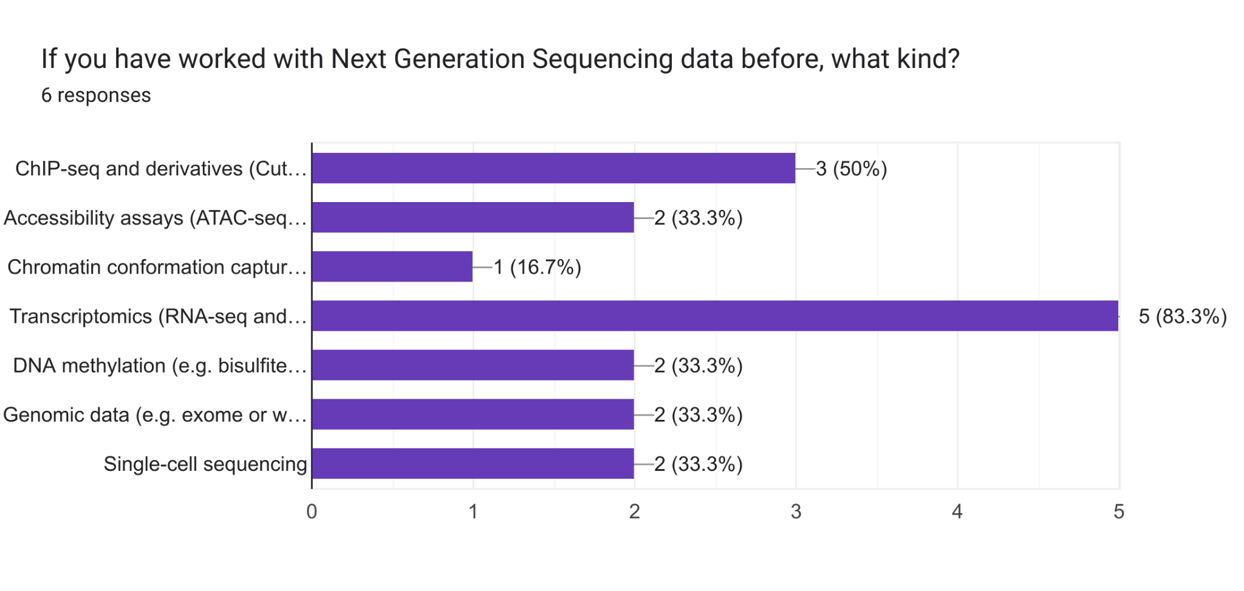

Slide 6
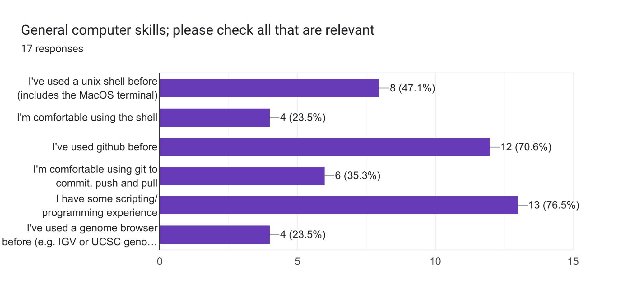
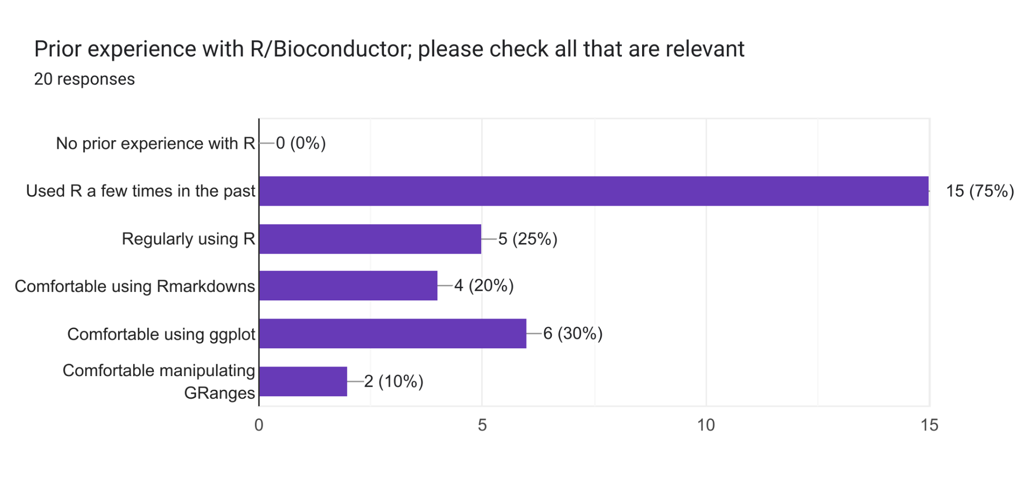

Slide 7
Some expectations given by your fellow students
“I hope to get more comfortable with the standard tools and procedures of epigenetics analysis. Also getting some useful tips and tricks regarding programming.”
“get some general knowledge about how to make use of genome browsers”
“Getting acquainted with analysis of regulatory data”
“Become more comfortable with using R, learning how to extract information from the genomic data”
“multi-omics knowledge, how to integrate those, and gene regulation dynamics”

Slide 8
Bioinformatic approaches to regulatory genomics and epigenomics
376-​1347-00L - 2022
Pierre-Luc Germain

Slide 9
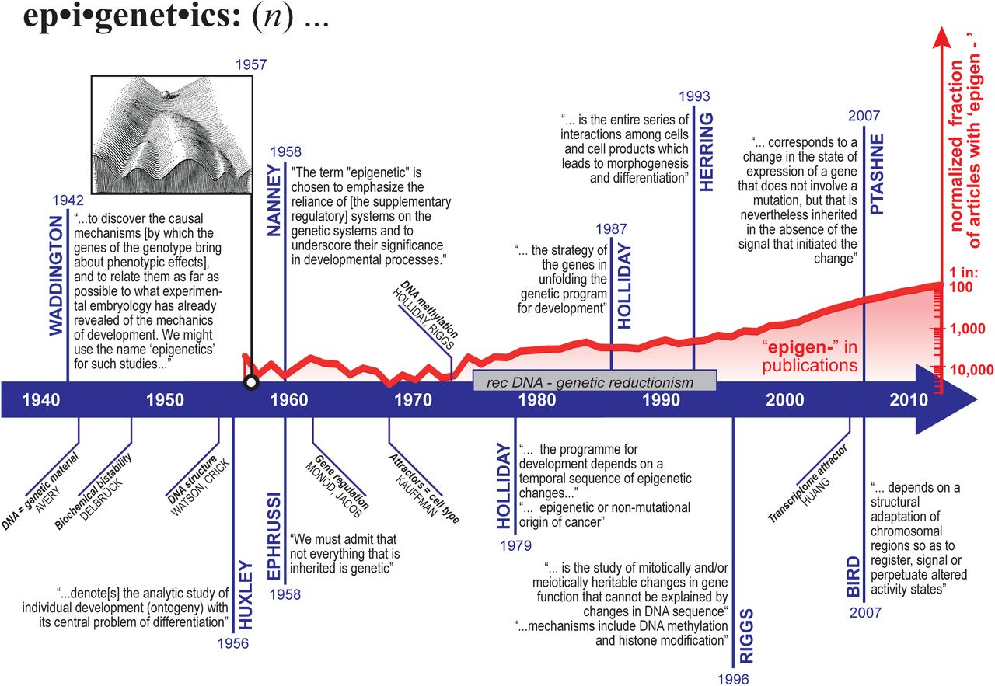
(Oliveira Pisco,
Fouquier d’Hérouël
and Huang, 2016)

Slide 10
Epigenetic(s)
Waddington (1942) :
“the causal interactions between genes and their products which bring the phenotype into being”
Ptashne (2007) (also Nanney 1958):
"A change in the state of expression of a gene that does not involve a mutation, but that is nevertheless inherited in the absence of the signal (or event) that initiated the change."
Bird (2007) and common contemporary usage in molecular biology:
"molecular modifications of DNA and chromatin that do not alter the sequence"

Slide 11
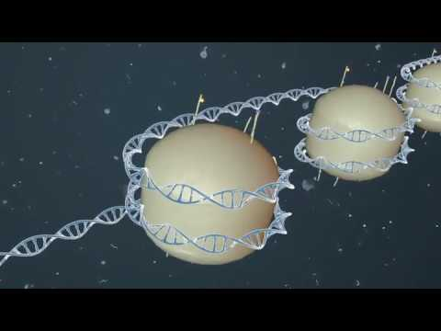
Basic primer on epigenetics

Slide 12
Epigenetic(s)
Waddington (1942) :
“the causal interactions between genes and their products which bring the phenotype into being”
Ptashne (2007) (also Nanney 1958):
"A change in the state of expression of a gene that does not involve a mutation, but that is nevertheless inherited in the absence of the signal (or event) that initiated the change."
Bird (2007) and common contemporary usage in molecular biology:
"molecular modifications of DNA and chromatin that do not alter the sequence"

Slide 13
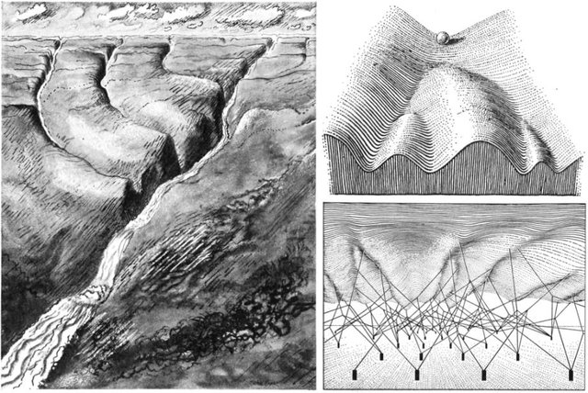
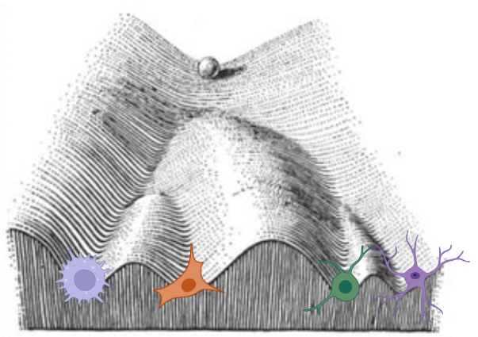
Waddington’s epigenetic landscape
Differentiation
Reprogramming
Trans-differentiation
Left from Waddington (1940) “Organisers & Genes”
Right from Waddington (1957) “The strategy of the genes”

Slide 14
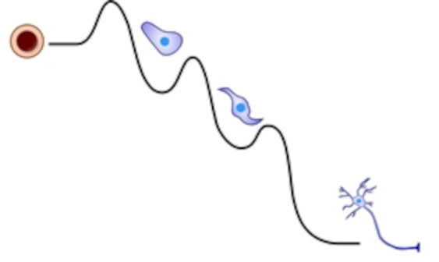
Maintaining and changing cell identity
pluripotent stem cell
ectodermal
progenitor
neural
progenitor
Developmental potential
attractor
states
neuron
Phenotypic space
(Adapted from an original figure by KT Rodolfa 2008)

Slide 15
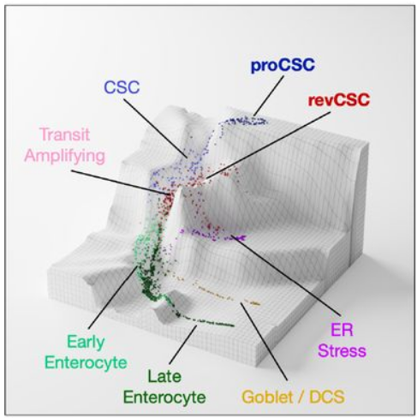
Maintaining and changing cell identity
From concept to quantitative measurement
pluripotency
(adapted from
Qin et al., bioRxiv 2023)

Slide 16
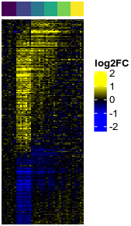
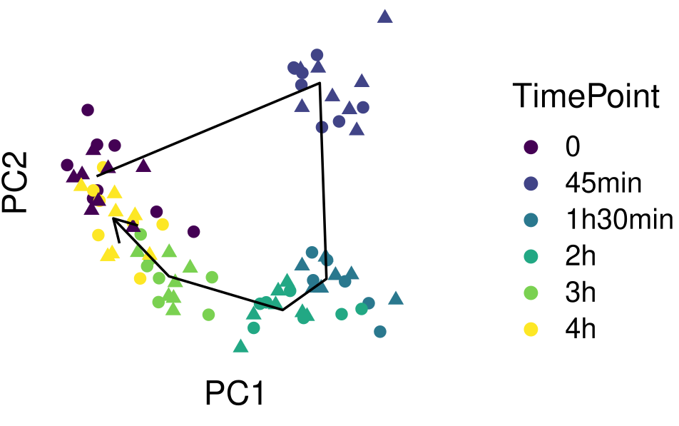
Regulating cell-type-specific responses to stimuli
stress
Relative expression
Genes
(from a study of the gene expression response,
in the hippocampus, to acute stress ; von Ziegler et al. 2022)
Time

Slide 17
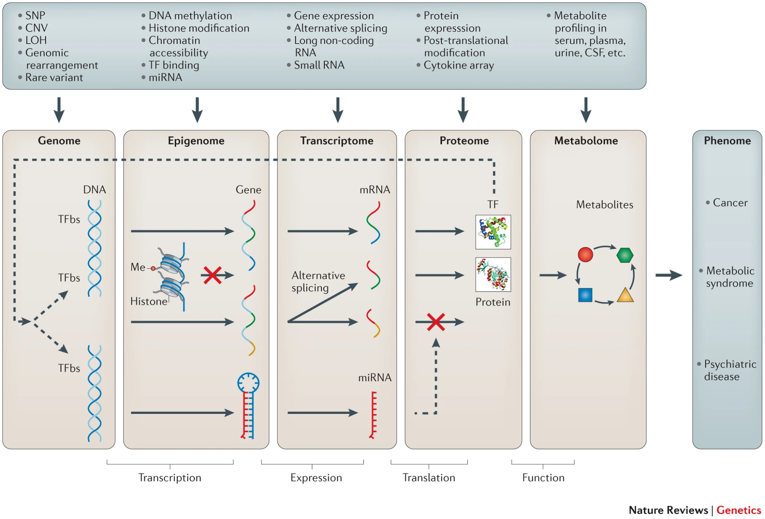
Situating the course
While genomics and transcriptomics are much more used in the clinics, until this course there was no dedicated teaching on epigenomics at UZH/ETH.
Students interested in transcriptomic analysis
may want to follow the excellent 401-6282-00L (UZH Sta426) course (emphasis on stats)
(Ritchie et al., Nature Reviews Genetics 2015)

Slide 18
Aims of the course
to enable students to be, if not wholly independent with respect to epigenomics data analysis, at least able to autonomously explore, visualize and interpret such data;
to understand and critically appraise, from a genomics perspective and through hands-on data exploration, the key concepts underlying chromatin regulation of transcription and its impact on various biological phenomena.

Slide 19
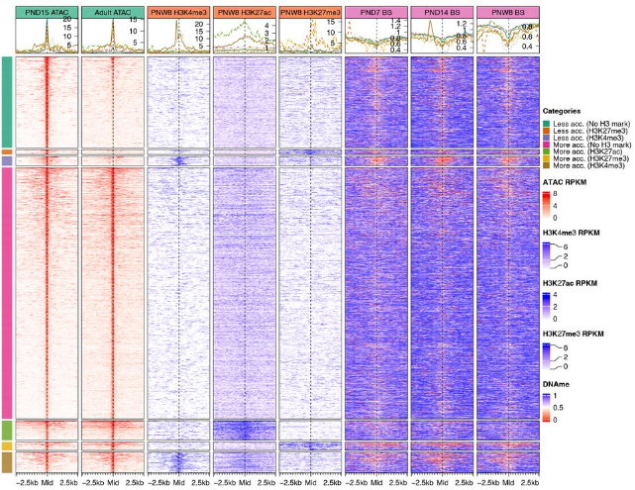
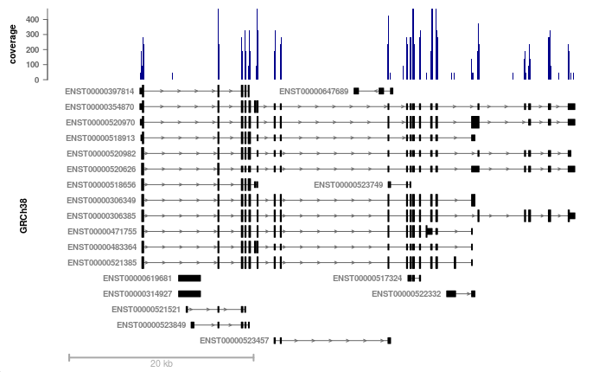
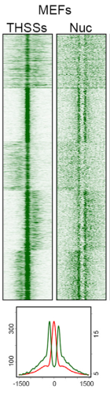
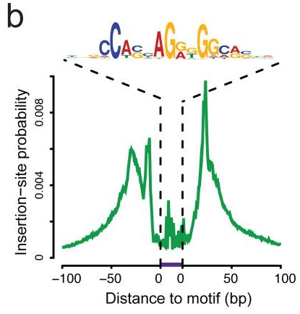
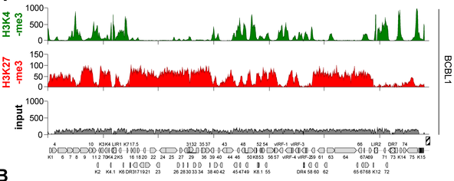
How does one make plots
like these, and
what do they tell us?

Slide 20
Grading and expectations
50% of the grade is based on weekly exercices
Exercices should be submitted via github, by thursday noon the following week
The best half of the exercises will make up the grade
50% of the grade is based on the project (alone or in groups of 2-3)
The project can be either:
Re-producing the analyses from a publication (in a critical fashion)
Analyzing new data (e.g. yours or in collaboration with a group)
The project must be discussed and approved in advance
The expected outputs of the project are:
a report (e.g. ~10-15 pages) with embedded full code and figures, and including an introduction and discussion of the results (40% of the grade)
a short presentation (10%)

Slide 21
Learning objectives
Weekly assignments
1.
Contrast different types of genomic signals
2.
Apply various visualization and statistical techniques to make observations
3.
Critically interpret data and synthesize biological messages
4.
Understand the determinants of cell fate, memory, and response to stimuli
Project

Slide 22
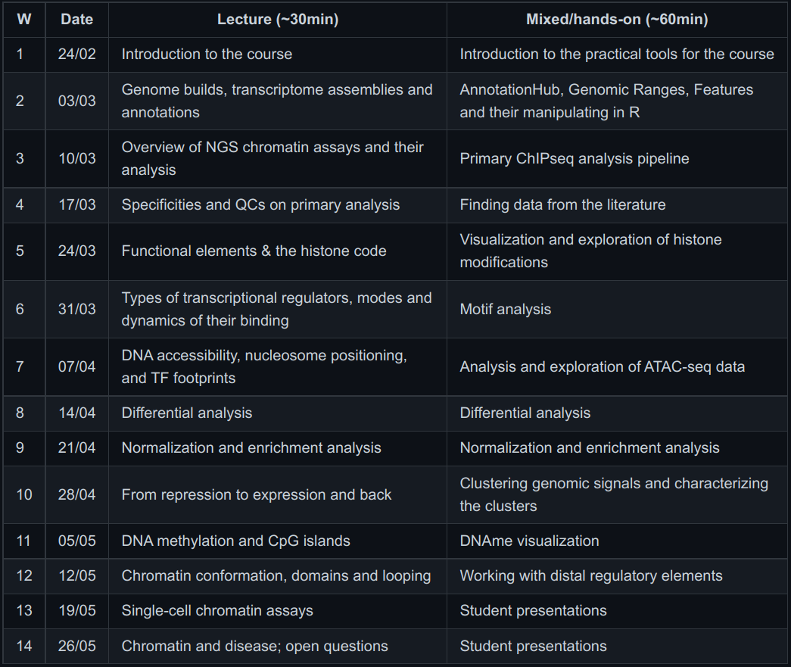
Tentative schedule
of the course
Each week:
~15min of debriefing on the exercises from the previous week
~30min of “lecture” to provide background and theory
~60min of hands-on demonstration (live coding)

Slide 23
The tools we’ll be using… and some documentation
Unix shell environment : short primer / long intro
R & Bioconductor : primer
(installation instructions for R, rstudio and bioconductor)
R markdowns : primer
git & github : tutorials
Particularly important for the course

Slide 24
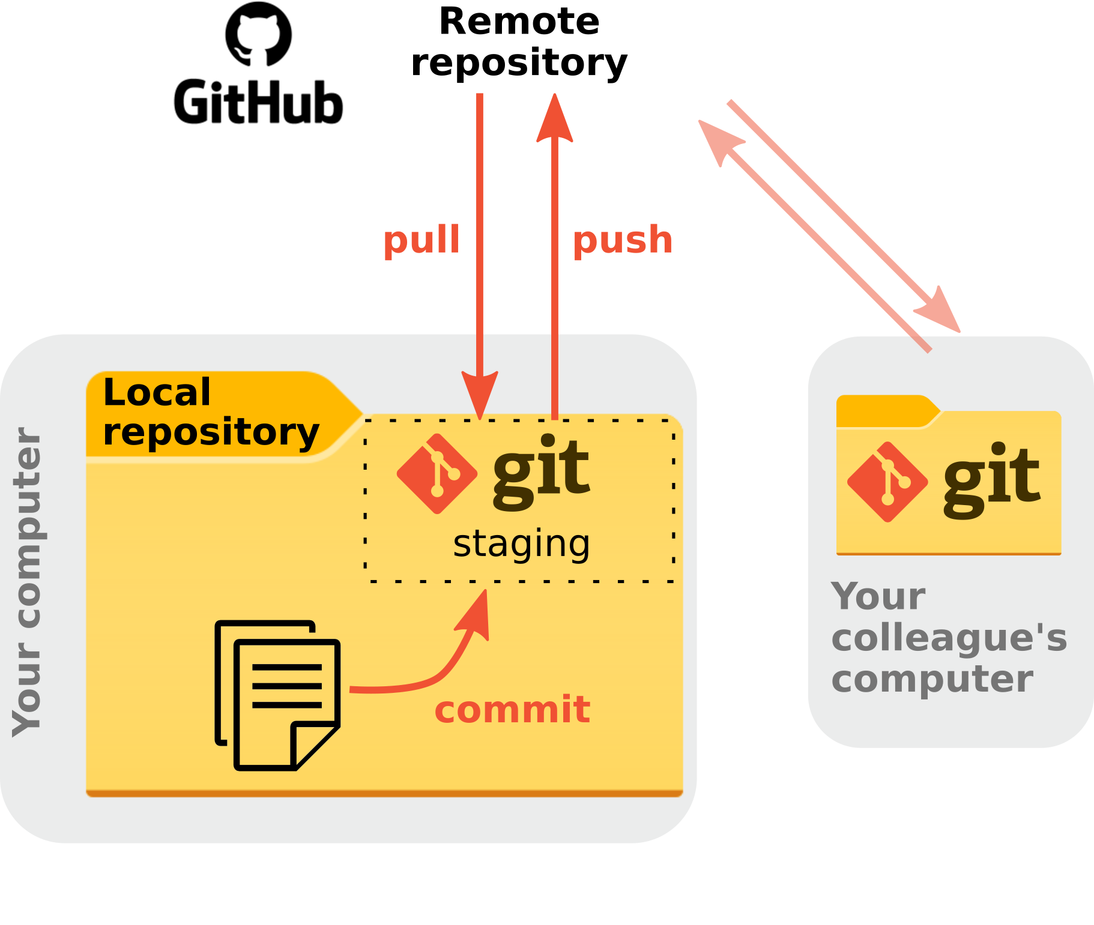
Introduction to
git and github

Slide 25
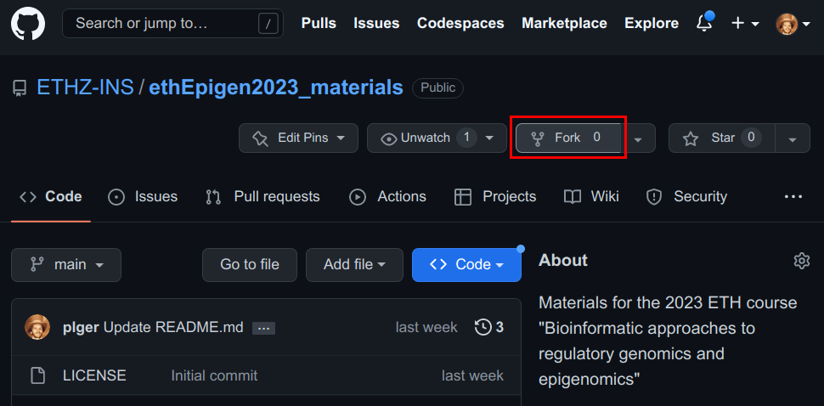
Setting up your github repository for the course:
If you don’t already have one, create a github account
Send us your github username on slack
Fork the course’s repository, and send me the link to your forked repo
To fork, go to https://github.com/ETHZ-INS/ethEpigen2023_materials , make sure you are logged into github, and click the “Fork” button

Slide 26
This week’s assignment
If you haven’t done it yet, install R, Rstudio, and Bioconductor
Install the packages we’ll need (see the install.R file on the repo)
Create a R markdown named “assignment.Rmd” in which you:
load the epiwraps library (using library(epiwraps) )
print the session info (using sessionInfo() )
Render your markdown, and push both the Rmd and html files to your github repo, in the directory week01/

